Slide 1
Open slides

Slide 2
Project Plans & Readiness

Slide 3
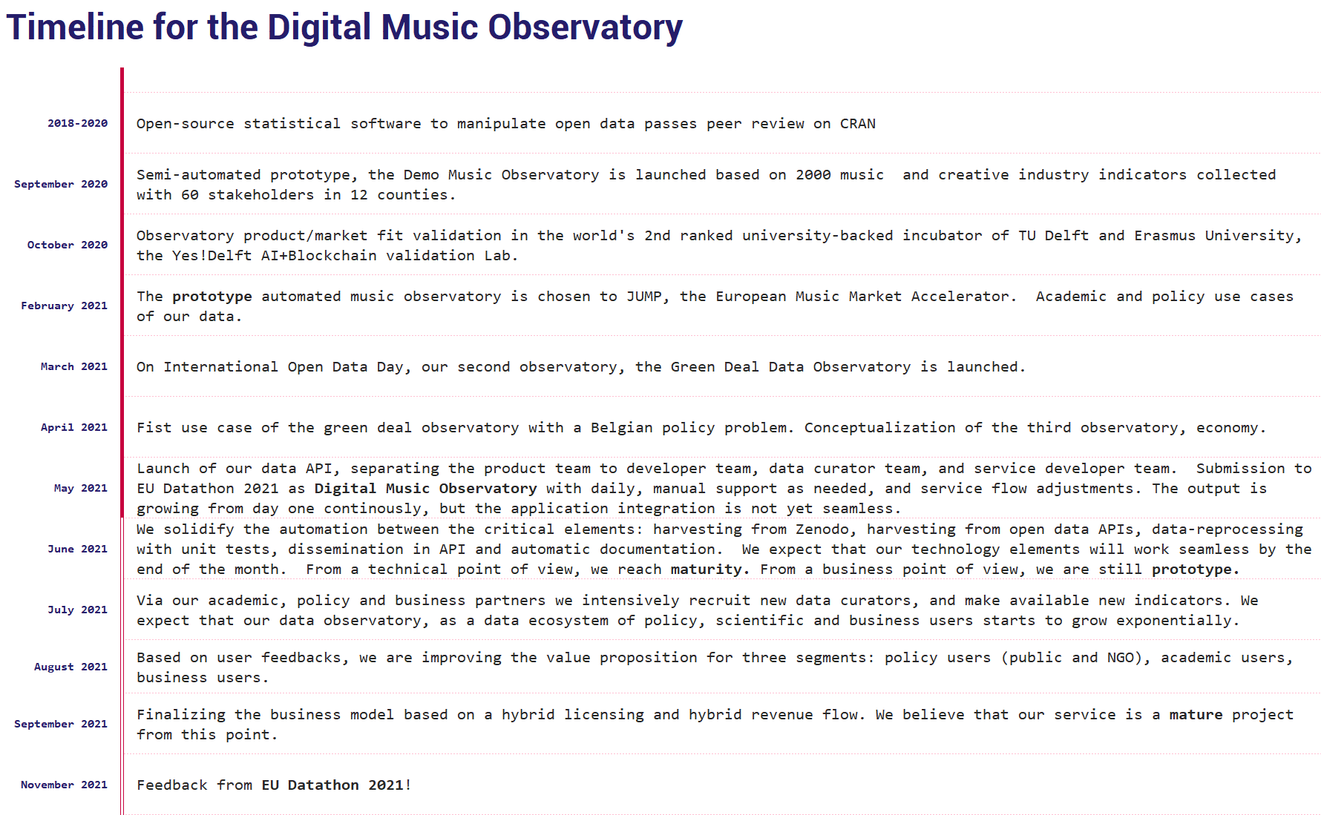

Slide 4
Legal & IP
Our submission is an open collaboration among private persons, research organizations and an early-stage startup, Reprex BV, which is developing a business model to process open data with open-source software. We do not plan any changes in the timelines of the EU Datathon 2021. Our prototypes currently have no significant income, and we hope to receive little contributions from first users. These will be invoiced by Reprex, and current costs are expensed by Reprex.
Reprex is supported by rOpenGov, which is a collaboration or R developers who write open source, peer reviewed software to access open data. Reprex’s software were released together with rOpenGov. rOpenGov is hosted by the University of Turku, and their contribution to the project is in-kind.
The development, data curator, and service development team members work in different organizations and their contribution is on a volunteer basis, and in-kind. They are not employed by Reprex, but Reprex pays some expenses (GitHub Action, Amazon AWS hosting.)
Technology and Freedom To Operate:
We did not apply for a patent.
We use only open-source technology, and we have complete FTO.
Our critical components are released under MIT, GPL-2, or GPL-3 and similar licenses, and go through the quality control of peer review in releases, mainly on CRAN.

Slide 5
Business Planning
How do users are going to pay?
We are aiming at the data acquisition budget of our public policy, NGO, consultancy and research institute clients, which is about 10-15% of their annual R&D spending ranging between €5k-50k.
We also want to win public tenders of the EU, OECD and UN to run ‘data observatories ‘. We want to keep as much as possible fully open and free.
What is the users ROI (rate on investment)?
For a research-oriented organization, they get 2-4x times more data with us, but how this translates to a research product / research (wage) cost is being quantified in our pilot projects.
The ROI is differently defined for a public policy organization, an NGO, a business consultancy or a scientific research organization.
What are your costs?
Our server costs were won in the Yes!Delft incubator from Amazon and paid from the Reprex account. Github automation costs are paid by Reprex.
So far, almost all our costs are fixed personnel costs, and all our team members work for free on a volunteer basis.
In our current competition setup, all contributors are volunteers, and we try to get from users a small budget for small expenses. These will be handled by Reprex.

Slide 6

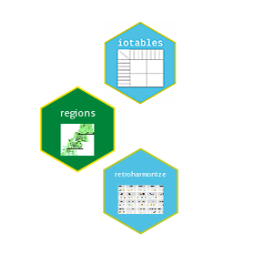
Technical Readiness Level
Technical readiness level:
Different components are on levels 5-8.
Our technological innovation lies in re-processing already existing public sector data, and mapping data sources, which enables us to create new and affordable features for AI apps.
We have passed TRL Level 5, and our prototypes are working in isolation. They are being tested as a seamless service flow now.
We only use open-source technology which usually overstates TRL Levels. We use others’ work, and contribute, too, our critical components are peer-reviewed statistical software releases. This makes or TLR higher than our business readiness.

Slide 7
Observatory specific

Slide 8
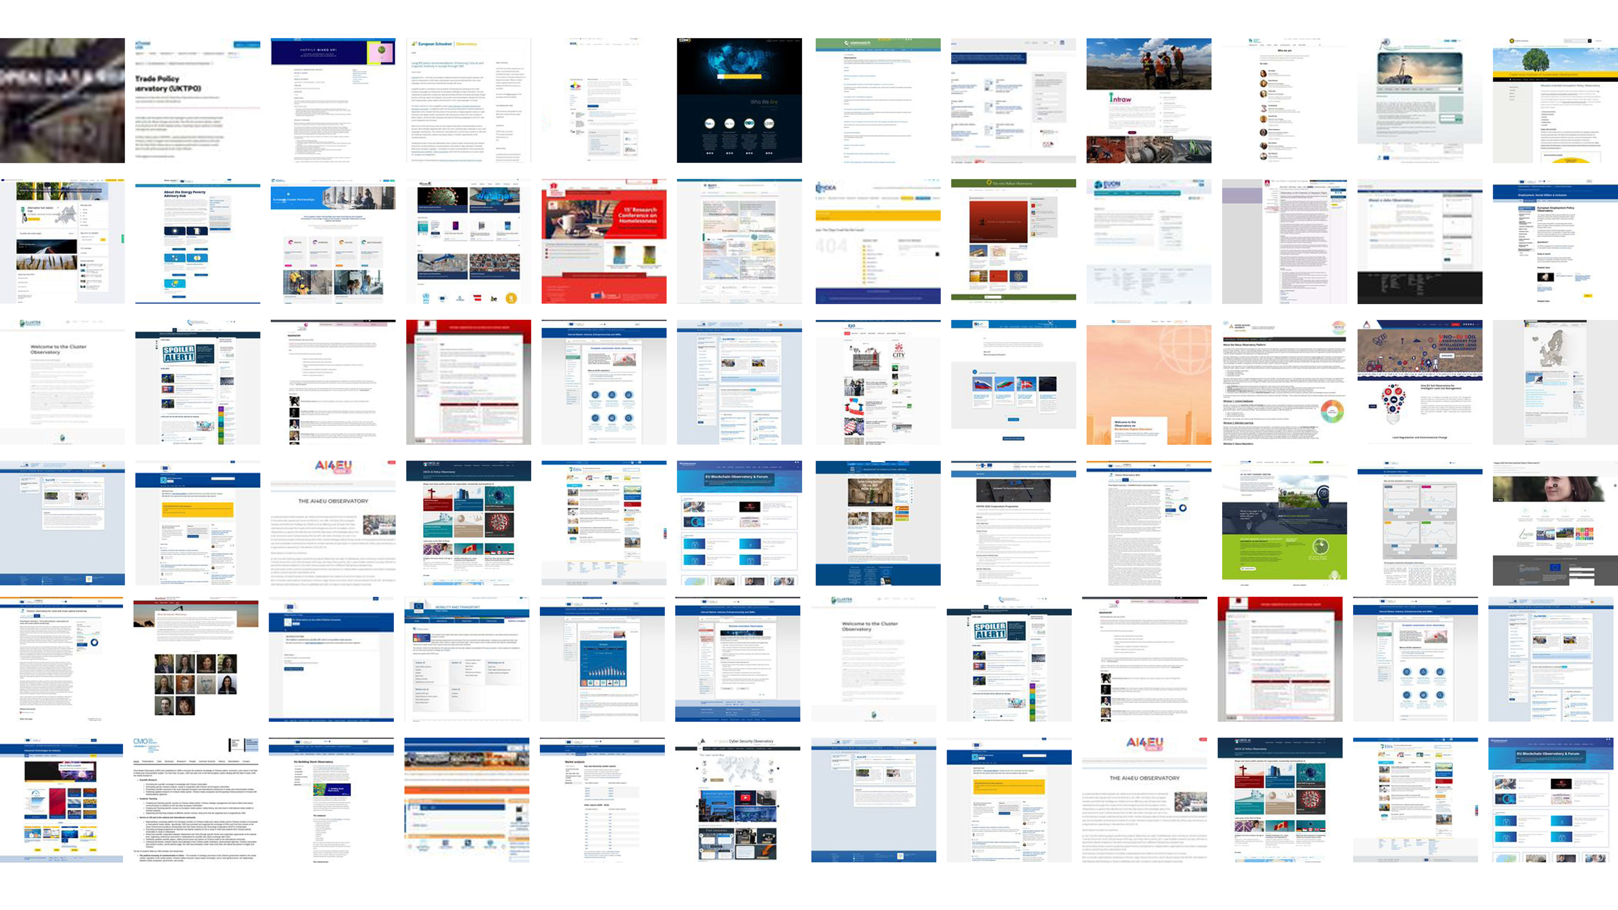
Why is Open Data Not Used?
Though data is usually valuable if it is not in isolation, open data is very difficult to join with other data. Almost never confirms the tidy data principles, which makes integration into databases or making composite indicators a very challenging data processing task.
Haphazard use of measurement units (gram vs kilogram), currencies, metadata codes (regional boundaries change several thousand times just in the EU over a few years.)
In short: open data requires investment into processing, unit testing, documentation to be usable. These are very costly operations, but we believe it can be done at scale and at a best value for money with open-source statistical code and research automation. This is what we do: create automated data observatories that reprocess, validate and automatically document open data to meet high statistical standards.

Slide 9
Observatory final opening page here

Slide 10
Why is open data not trusted?

Slide 11
Why is Open Data Not Used?
Though data is usually valuable if it is not in isolation, open data is very difficult to join with other data. Almost never confirms the tidy data principles, which makes integration into databases or making composite indicators a very challenging data processing task.
Haphazard use of measurement units (gram vs kilogram), currencies, metadata codes (regional boundaries change several thousand times just in the EU over a few years.)
In short: open data requires investment into processing, unit testing, documentation to be usable. These are very costly operations, but we believe it can be done at scale and at a best value for money with open-source statistical code and research automation. This is what we do: create automated data observatories that reprocess, validate and automatically document open data to meet high statistical standards.

Slide 12
Why is Open Data Not Used?
Open data is released after primary governmental, scientific or corporate use. It is not processed and organized to the new user’s needs.
The data is poorly documented, the primary user does not have an incentive to hire a data scientist or statistician to provide important metadata for the information: it needs to be reverse engineered to figure out important aspects of the data.
The EU, OECD, an UN bodies are (co-)financing more than 60 permanent data collection points, so called ‘observatories’ or ‘data observatories. Our market research found they almost never use any form of open data. We believe that it is a wasted opportunity to spend millions of euros on each data observatory’s collection problem when billions worth of open data (at historical cost) is not even considered in them.

Slide 13
How can we build up the missing trust?

Slide 14


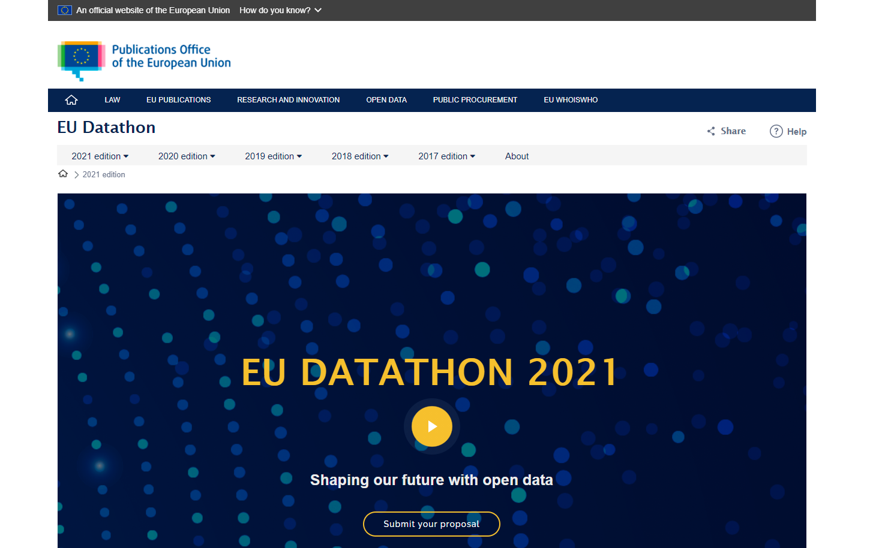
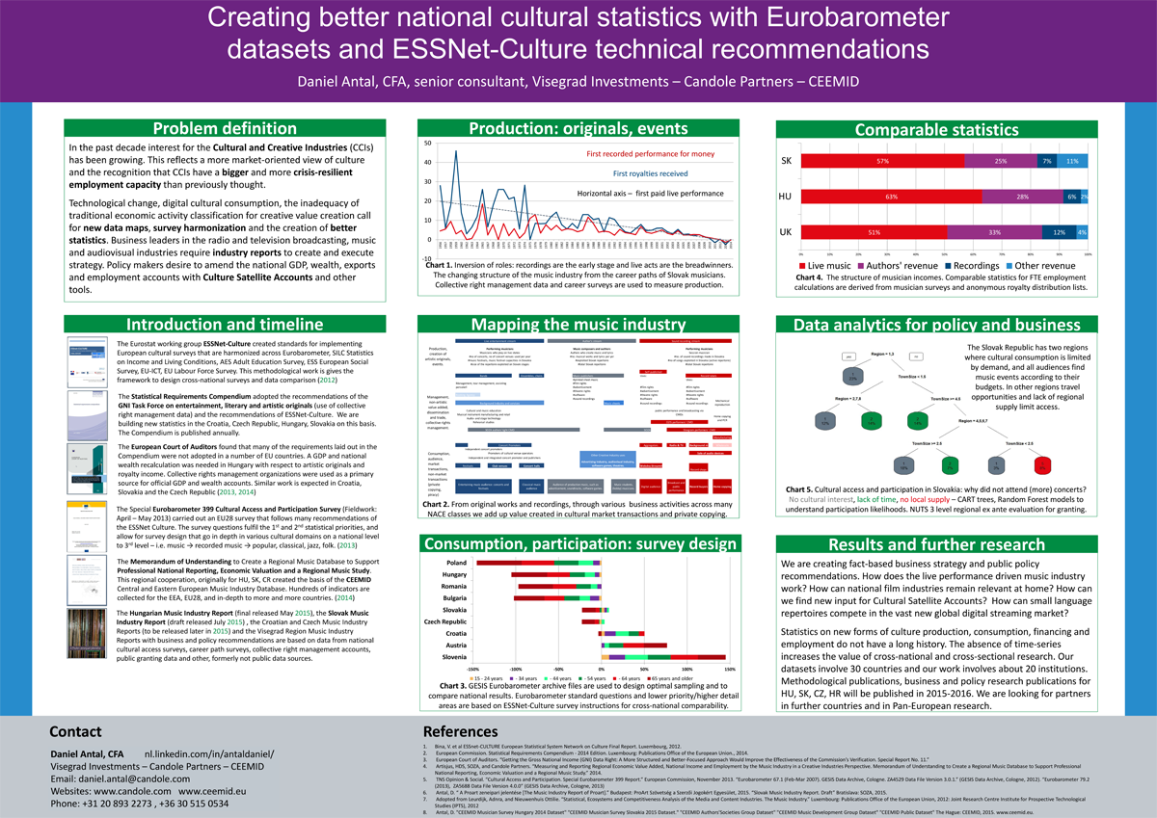
OSINT & Open-Source Market Research
We do what bellingcat does with open-source intelligence in journalism: programmatically sift through vast mountains of open data and try to select and verify those that meet high business, scientific or policy evidence standards.

Slide 15
Accuracy & Reliability
1 . Our curators design unit-test and other other tests to check the accuracy and reliability of our indicator before release.
2. Our currators send the data products in-context peer review in their domain.
1 . Our statistical software code contains many unit-tests to avoid reliability issues.
2. Our processing code goes through scientific software peer-review.
3. The authoritative copy/version is stored on Zenodo with DOI/version.
Timeliness & punctuality
1 . Our curators help us find frequently updated data sources.
2. We aim to design leading indicators that accurately forecast the expected measurement.
1. We use research automation: or code collects new data, revisions every day, and re-processes the data.
2. Our API immediately releases the new data.
Coherence & Comparability
1 . Our curators are selecting data and designing indicators that can be joined with all other indicators in our observatory.
2. We make sure that the timeframe, unit, currency, and other aspects make the data comparable.
1 . Our software + API fully embraces the tidy data concept,. It makes integration with all our data, and other databases easier and less likely to cause logical errors.
2. We aim for a large cross-section of observations (all Europe), timeframe, and several indicators for cross-comparison.
Accessibility & Clarity
1 . Our curators place our data in scientific publications, open policy analysis, and business use cases to make sure that they they makes sense.
2. Our open collaboration method offers user feedback from academia, public and NGO policy and business users.
1 . Our API contains a daily refreshed full set of our indicators (we aim at 100-200 indicators in the observatory)
2. Our documentation website is automatically refreshing the indicator description, the data overview and the latest metadata (new observations, new imputations, etc.)
We aim to increase the quality of existing open governmental indicators, such as Eurostat products, and to design new indicators that are at least on the quality level of Eurostat’s products. Our quality assurance follows the following methodology.
1. Towards a harmonised methodology for statistical indicators — Part 1: Indicator typologies and terminologies - 2014 edition (pdf)
2. Towards a harmonised methodology for statistical indicators — Part 2: Communicating through indicators (pdf) 3. Towards a harmonised methodology for statistical indicators — Part 3: Relevance for policy making (pdf)

Slide 16
What is our technology?

Slide 17
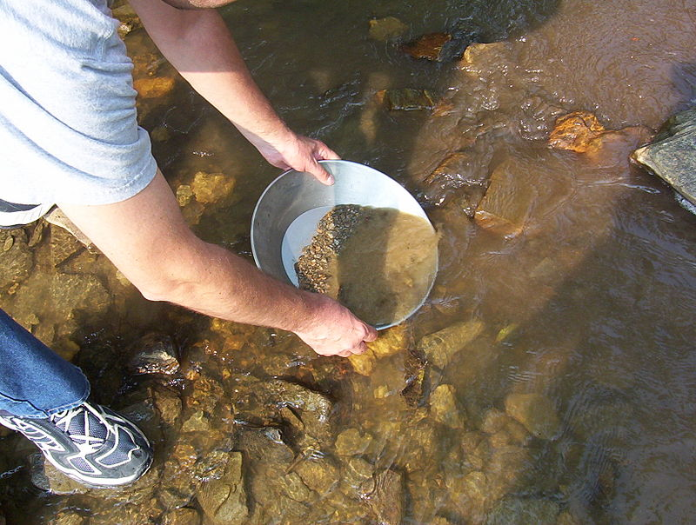
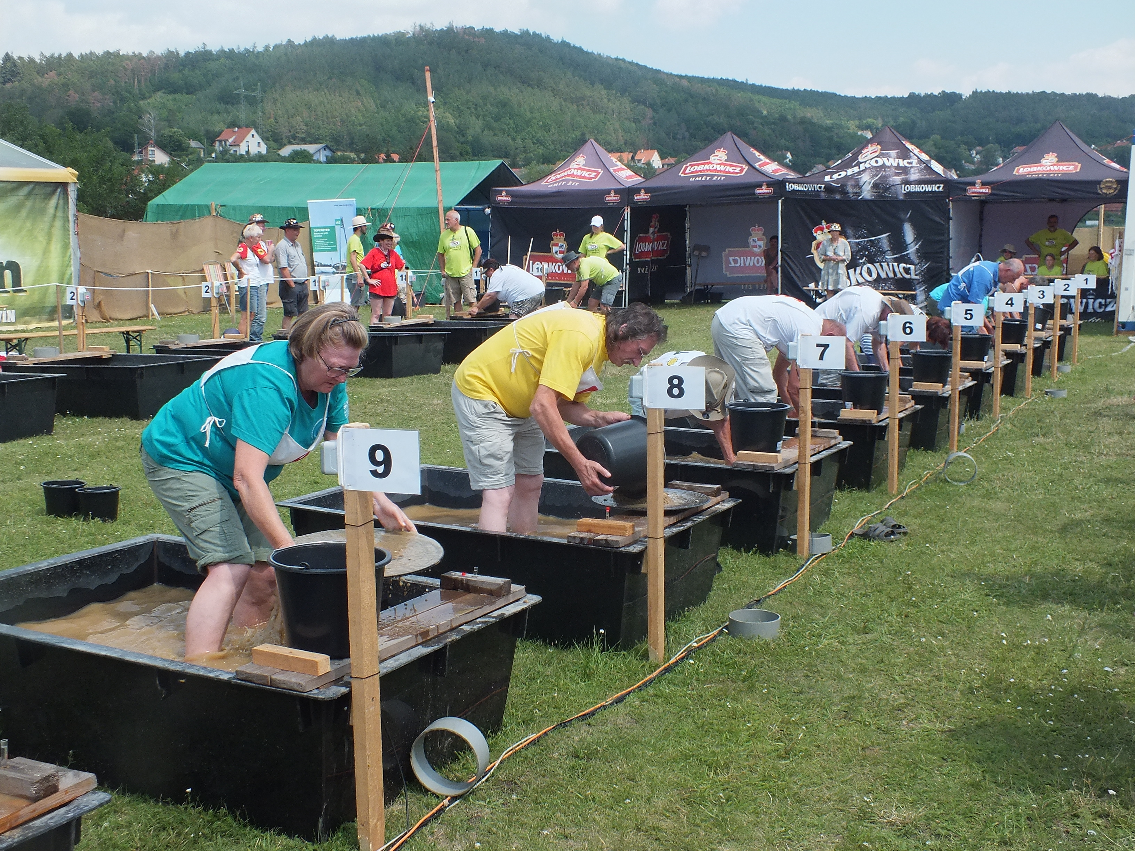
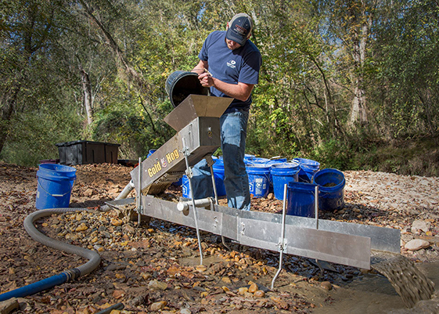
Technology – panning out gold from muddy open sources
Collect
retroharmonize
regions
Re-process
Recode/ transform
Impute, correct
Release
Automatic documentation
Placement in research projects
Iotables
R/Phython
Data API
Validate, test
Our retroharmonize, regions and iotables software has each about 1000-2000 specialist users worldwide.
The users are potential collaborators to pan out more open data and potential clients to produce high-quality research products.

Slide 18
Kasia curated list slide
Combining ex ante and ex post survey harmonization allows to create small scale surveys, such as simpler online surveys, that are more representative, or fully representative of a population.
This method combines new research information with pre-existing information, for example, in the European Values Survey, Eurobarometer, Afrobarometer, EU LFS, etc.

Slide 19
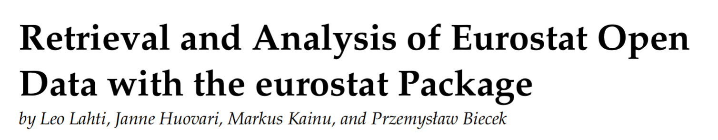
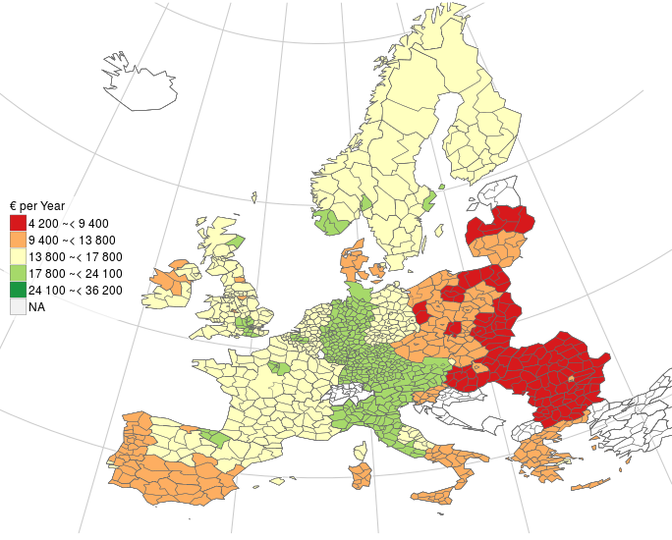
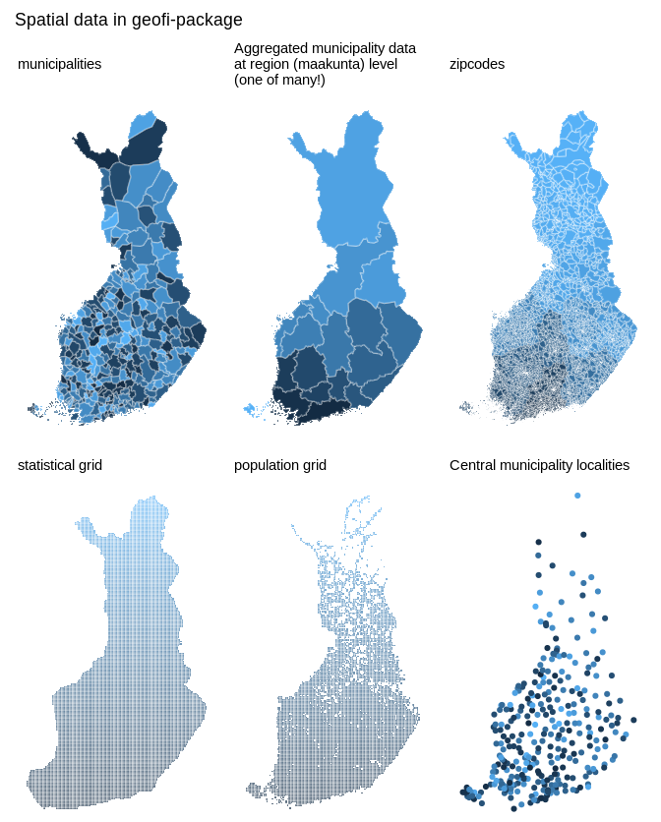
.org
Open developer network for open government data analytics in R
30 R packages in various stages of development; 10,000+ downloads/month
Launched at the NIPS Machine Learning open-source software workshop 2013
Active developers from 5 countries; coordinated by University of Turku, Finland
This is a compilation of mature R packages that collectively provide tested tools to retrieve, refine, enrich, integrate, and analyse open government data from Eurostat, national statistical authorities, geospatial information, and other sources
Seamless incorporation of open data streams with state-of-the-art statistical and probabilistic programming techniques and reproducible data science workflows
R Journal 9(1):385-392, 2017
(C) EuroGeographics for the administrative boundaries
Eurostat open data: average household expenditure in 2011

Slide 20
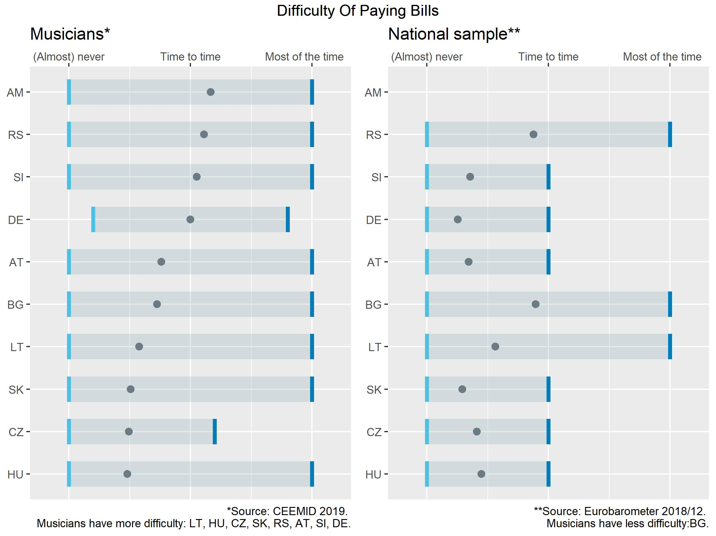
Ex Ante Survey Harmonization
Combining ex ante and ex post survey harmonization allows to create small scale surveys, such as simpler online surveys, that are more representative, or fully representative of a population.
This method combines new research information with pre-existing information, for example, in the European Values Survey, Eurobarometer, Afrobarometer, EU LFS, etc.

Slide 21
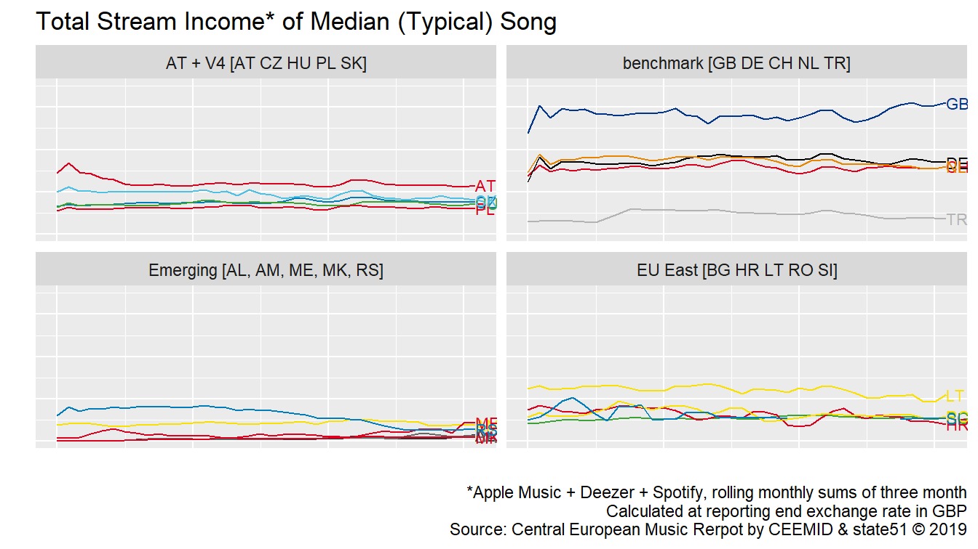
Systematic Sampling of Big Data
Many researchers know how to query the Spotify or YouTbue API, but how to do it in a representative and reproducible manner?
The income of a typical song in 20 countries, 2015-2019, monthly values.

Slide 22
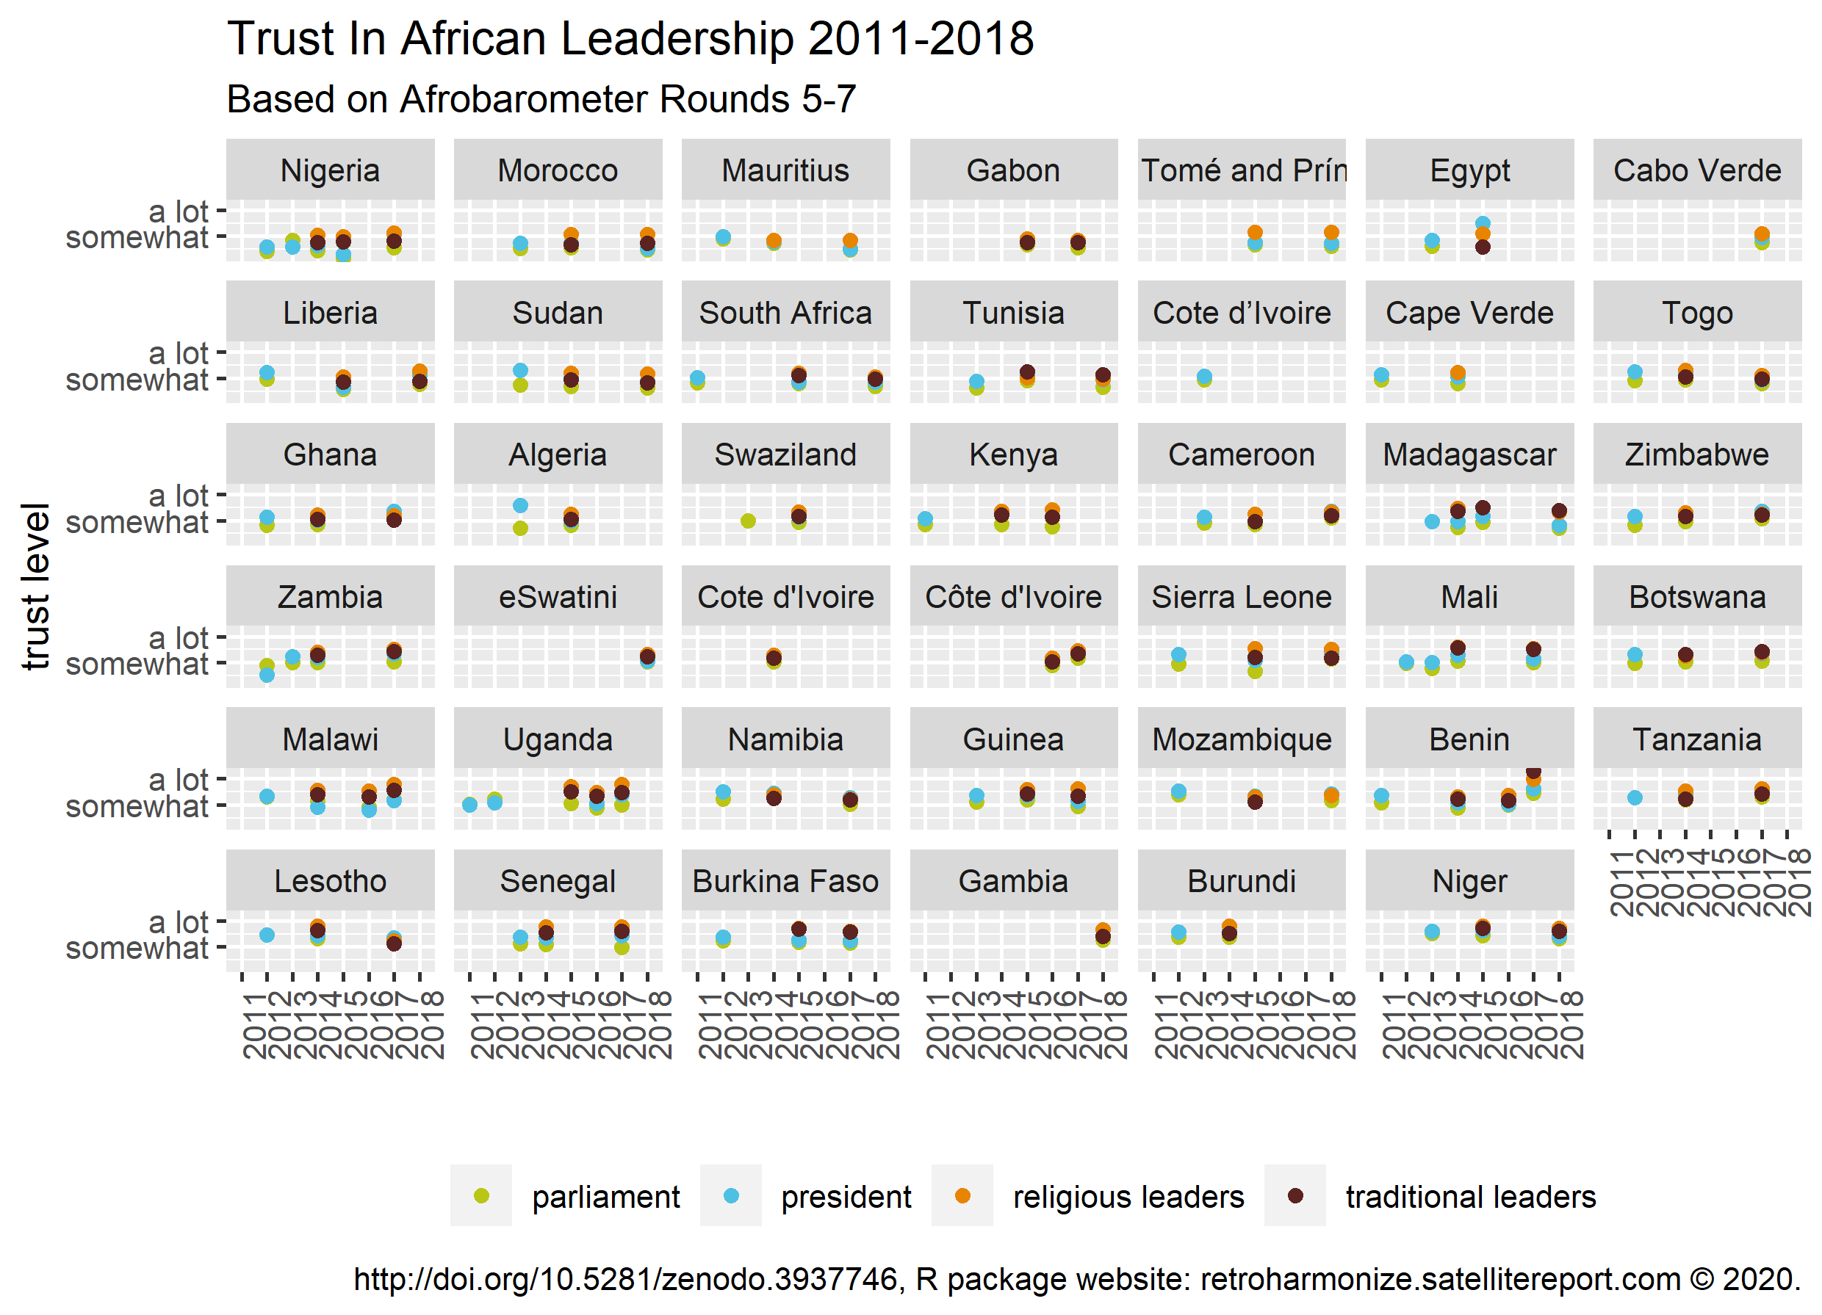
Ex Post Survey Harmonization
Ex post survey harmonization allows the combinations of pre-existing micro-level data, either published, or available for researchers, for example in the Eurostat microdata research.
It can combine international datasets without having to commission a new survey

Slide 23
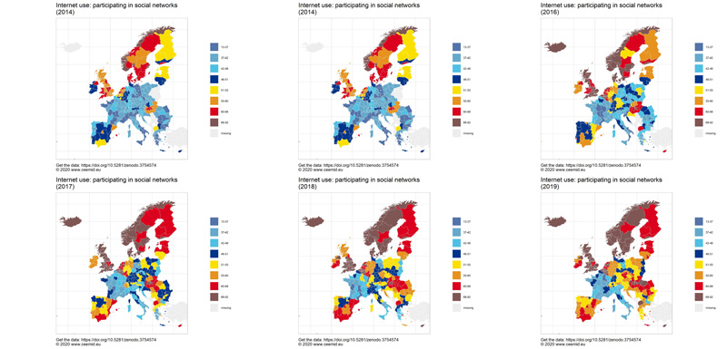
New Statistical Indicators
Statistical agencies and governments collect many-many times more data than what eventually is released as statistically aggregated data products (for example, the GDP or regional GDP indicator, literacy indicators, etc.)
Via rOpenGov and our peer-reviewed statistical softwares, we have access to the raw data of Eurostat and other governmental and scientific agencies covered by the EU Open Data Directive, or similar legislation in other jurisdictions, and using the very same methodology of Eurostat, OECD, we can create similar statistical indicators ahead of the official publication date, or in details that are not published by the statistical agency.

Slide 24
What is our service?

Slide 25
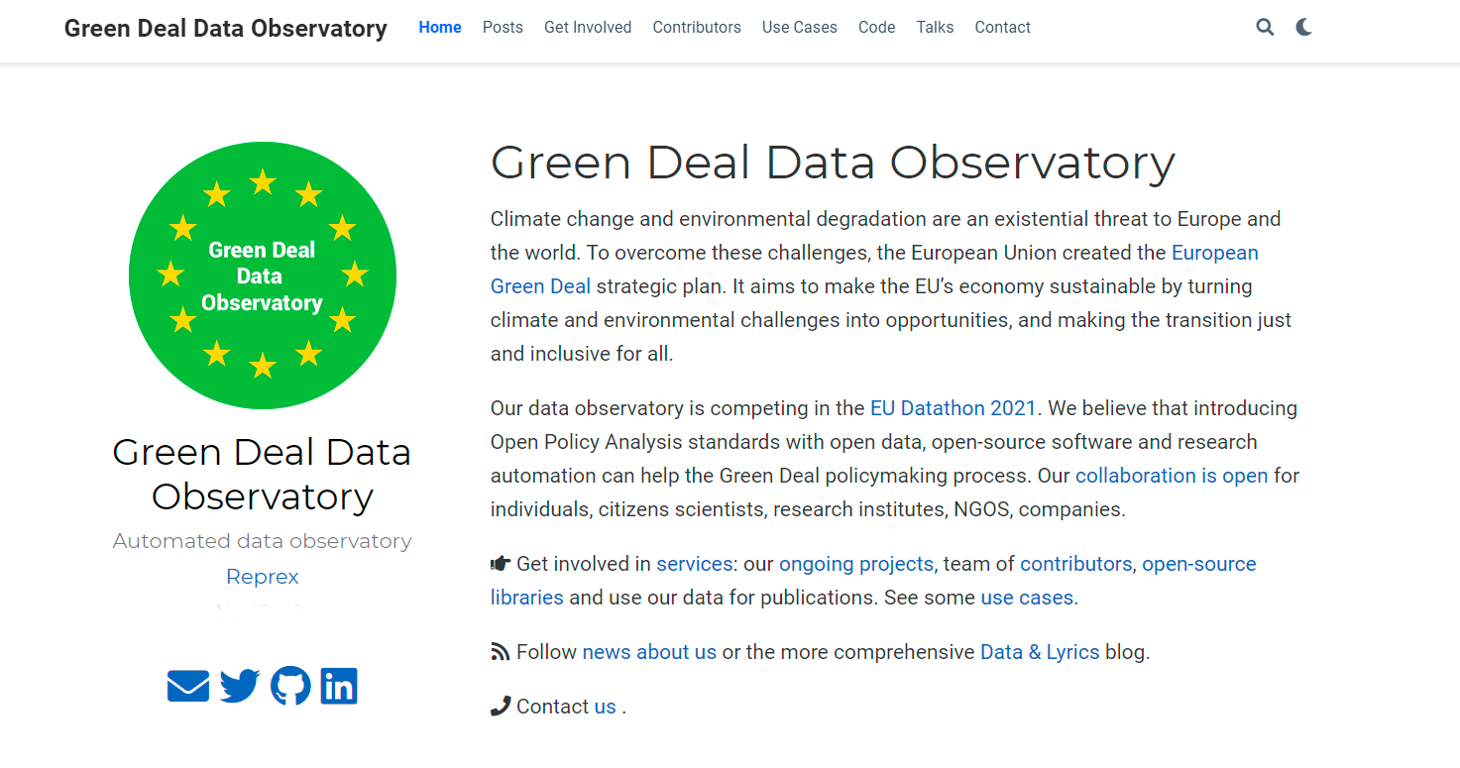
Obervatory specific screenshot

Slide 26
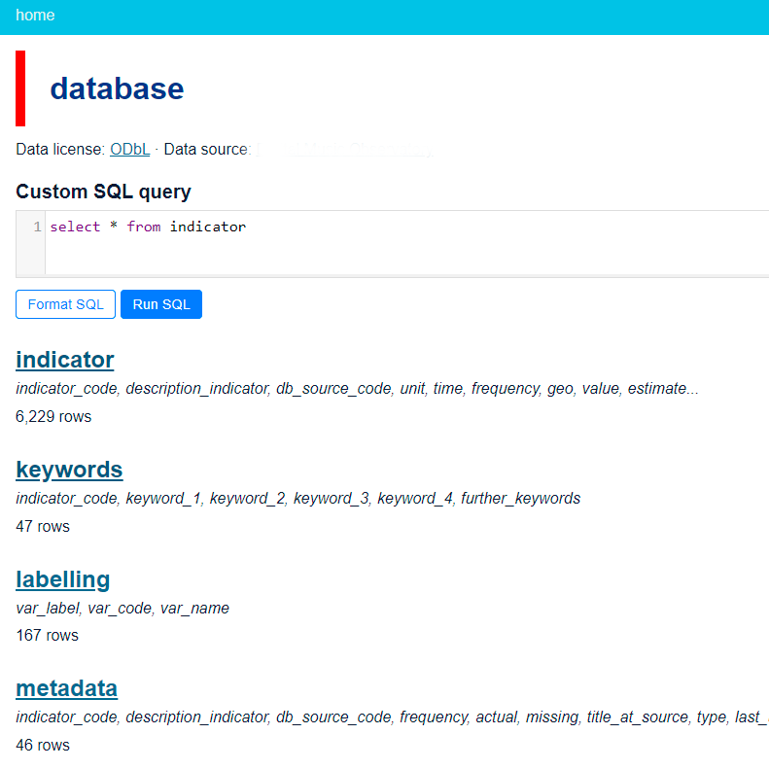
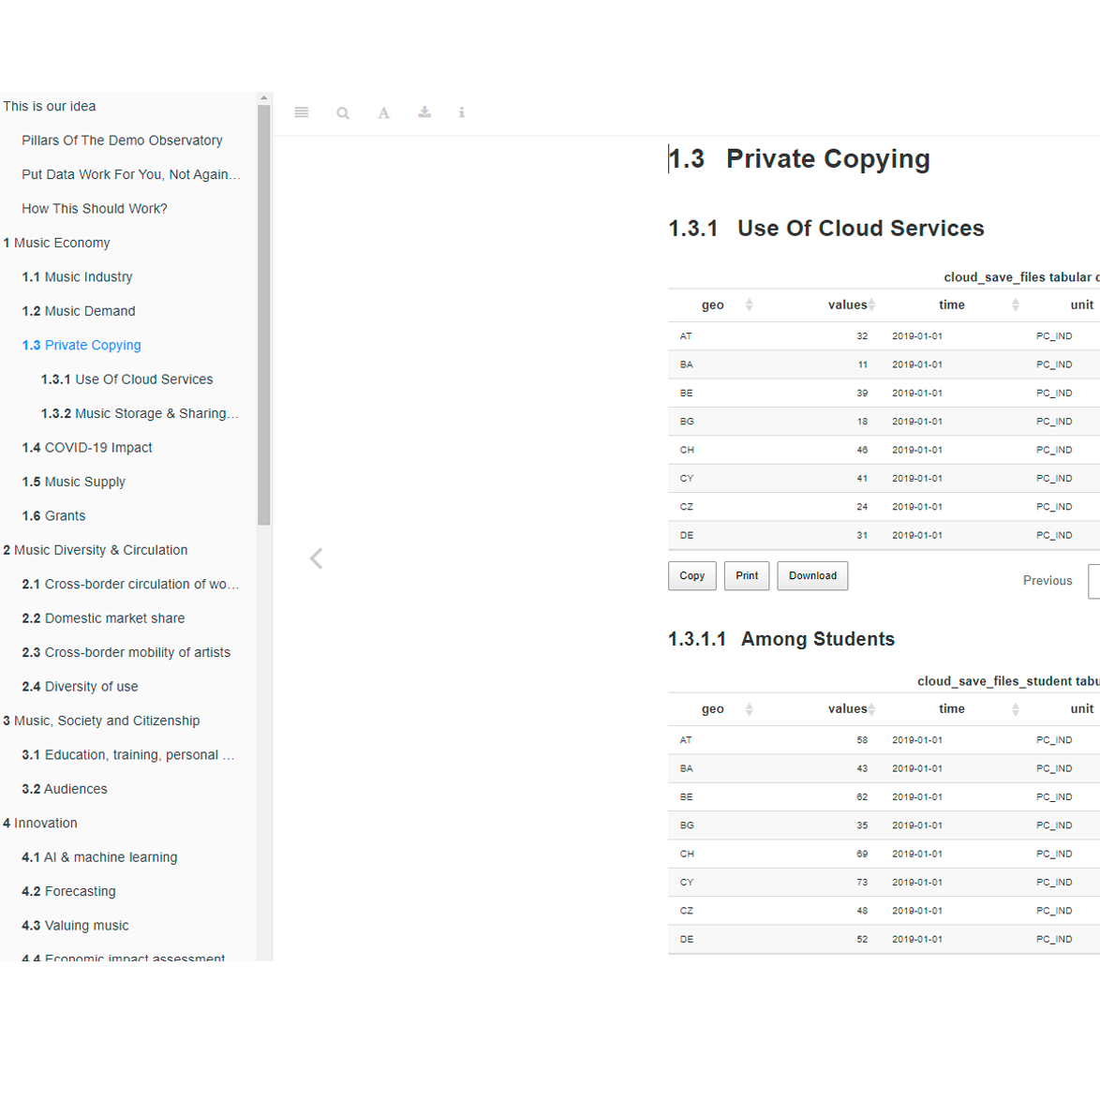
A modern, ODBL open API with daily refreshing indicator, processing and descriptive metadata. Download via SQL or in simple csv tables.
A daily refreshing long-form documentation with explanations, visualizations and human readable metadata.
A dedicated community space on Zenodo for authoritative data copies with DOI.
We would like to integrate our data flow with your research workflow. Our service design team is looking forward to requests from public and NGO policy users, researchers and consultants.
Observatory specific screenshot
Observatory specific screenshot
Website with tutorials and use cases of the data from leading experts.

Slide 27
Data sources

Slide 28
Open governmental data: We access re-usable public sector information covered by the Open Data Directive, and various freedom of information legislation.
Observatory specific text
Open scientifc data: We access re-usable scientific data from the Zenodo repository
Observatory specific text
Data sharing: We are encouraging our users and data curators to share their properietary data through us. Data is getting exponentially more valuable in integration than in isolation. We incentives data sharing with 8 years of industry experience
Big data sources, satellites: We are monitoring various transitory but open APIs, satellite images and other continous “big data” sources and use novel statistical technology to capture them into permanent, reliable and timely statistical, business, policy or scientific indicators.

Slide 29
Obervatory specific data source list

Slide 30
Team credits

Slide 31
Obervatory specific final screenshot

